Slide 1

Logistic Regresssion
Supervised Learning
08/01/2025

Slide 2
Contents
01
02
What is Logistic Regression
Why we use it?
03
04
It’s Working
Pros n Cons
05
Task Output

Slide 3

Logistic Regression is a supervised machine learning algorithm used for binary classification problems, where the output variable has exactly two possible outcomes.
Typical representations:
0 → Negative / No / False
1 → Positive / Yes / True
Although the term regression appears in its name, Logistic Regression is a classification algorithm because the final output is a class label, not a continuous value.
What is Logistic Regression?

Slide 4
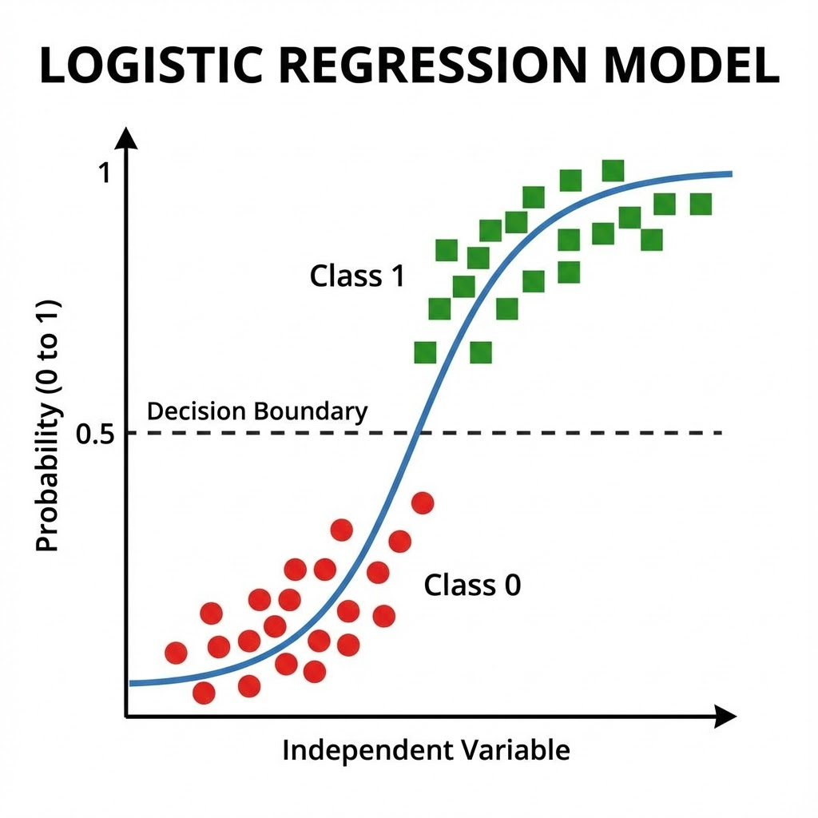
Why do we use Logistic Regression?
Linear Regression is not suitable for classification tasks because:
It can predict values outside the range ([0, 1])
It does not provide probabilistic interpretation
It fails to create a proper decision boundary
Logistic Regression overcomes these limitations by:
Applying a sigmoid (logistic) function
Mapping real-valued outputs to probabilities
Restricting predictions to the interval ((0, 1))

Slide 5
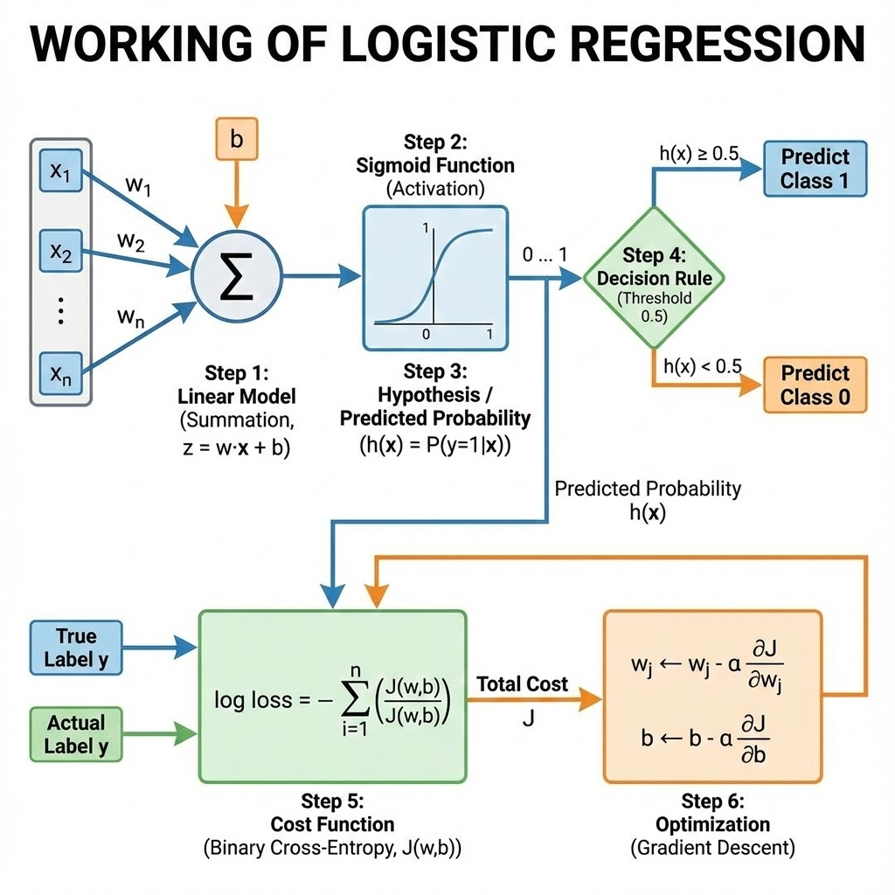
How does Logistic Regression work?
Class prediction rule:
σ(z) ≥ 0.5 → Class 1
σ(z) < 0.5 → Class 0
Loss function:
Binary Cross-Entropy (Log Loss)
Loss equation:
L = −[ y log(p) + (1 − y) log(1 − p) ]
Optimization method:
Gradient Descent
Parameter update:
w = w − α ∂L/∂w
b = b − α ∂L/∂b
Stopping criterion:
Loss convergence or max iterations
Input features:
x = (x1, x2, …, xn)
Linear combination:
z = w1x1 + w2x2 + … + wnxn + b
Activation function:
Sigmoid function
Sigmoid equation:
σ(z) = 1 / (1 + e^(−z))
Probability output:
P(y = 1 | x) = σ(z)
Decision threshold:
Threshold = 0.5

Slide 6
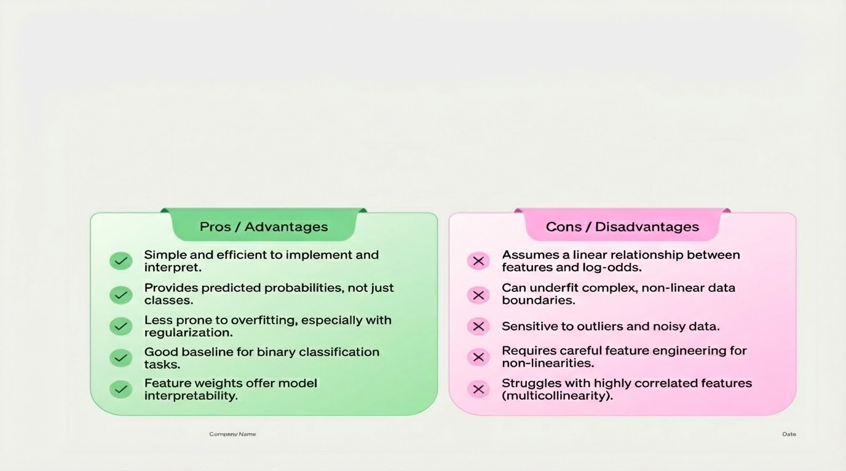
Pros n Cons

Slide 7
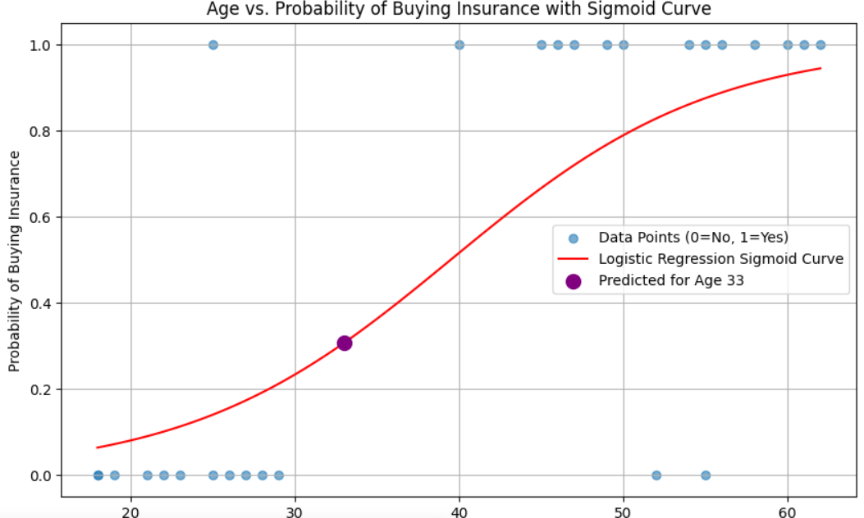
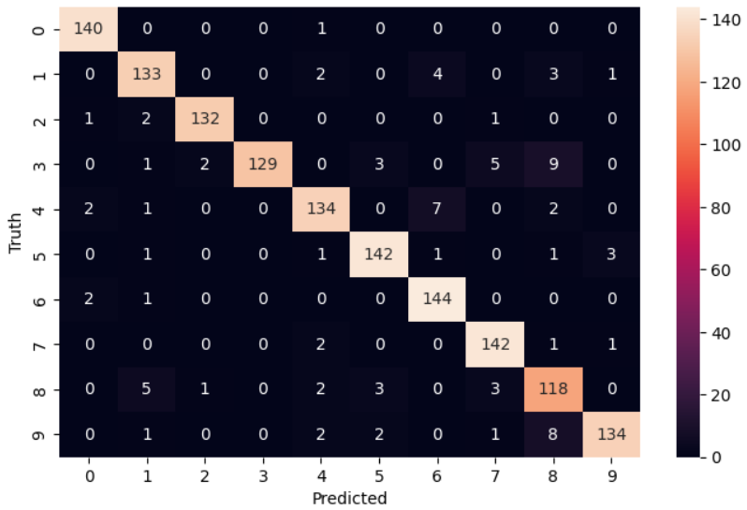
Task
Output of Binary Logistic Regression
Heat Map of Multiclass Regression

Slide 8
Thank you!

